Slide 1
Fake News Detection Using Transformer Model Team Members: Abhishek Chaudhary THA076BCT003 Adhip Bhattarai THA076BCT004 Kshitiz Poudel THA076BCT018 Nandan Singh THA076BCT020 Department Of Electronics and Computer Engineering Institute of Engineering, Thapathali Campus 6th Jan, 2023

Slide 2
Contents
Motivation
Objectives
Scope of Project
Methodology
Expected Result
Applications of Project
Tentative Timeline
References

Slide 3
Motivation
Increase of fake news in social media
Use of fake news for political gain in Election of Nepal

Slide 4
Objectives
Promote critical thinking and media literacy
Maintain the integrity of the news ecosystem

Slide 5
Scope of Project
Detection of text based news as real or fake
Compare base BERT and BERT-hybrid model
Design of webpage

Slide 6
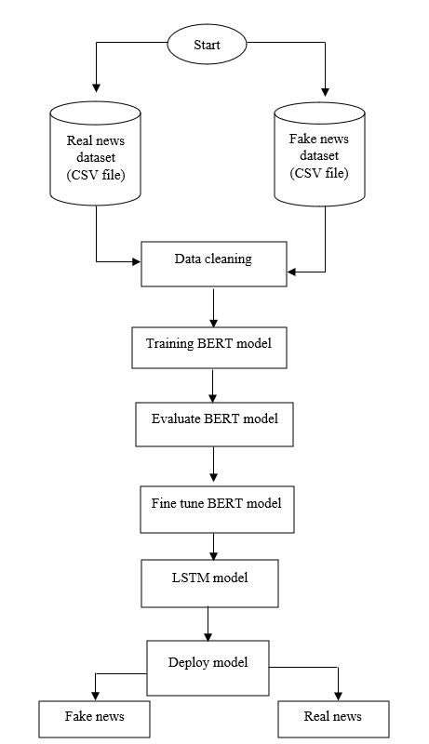
Methodology
Fig: System architecture

Slide 7
Methodology
•Data Collection:
•Data required for training and testing the model get from Kaggle
•Data are in .CSV format
•Data Pre-processing:
•Lower casing every word
•Remove punctuation and stop words
•Tokenization: separating text into smaller units

Slide 8
Methodology
•Training Model:
•Dataset is pre-processed and optimization algorithm is chosen
•Train the model by feeding the data
•Adjusting the model parameters to minimize the loss function
•Evaluating the Model:
•Evaluate performance on separate dataset
•Evaluation Metrices for this task is Accuracy, Precision, recall and F1 score

Slide 9
Methodology
•Fine-Tune the Model:
•Performance increased by adjusting learning rate, choice of optimization algorithm
•LSTM layer:
•Use LSTM layer to increase news classification accuracy
•Compare the parameters of hybrid-BERT and BERT-base model

Slide 10
Methodology
Deploy the Model:
• Deploying model as web application, verifying news articles
•Verifying news articles as real/fake by using news title or text.

Slide 11
Methodology
Instrumentation
Software:
Platform: Google Colaboratory
Libraries: NumPy, Pandas, Matplotlib, Seaborn, PyTorch, TensorFlow, scikit learn
Language: Python, HTML, CSS, Javascript, Flask

Slide 12
Applications of Project
Protecting integrity of elections
Safeguarding public health
Business

Slide 13
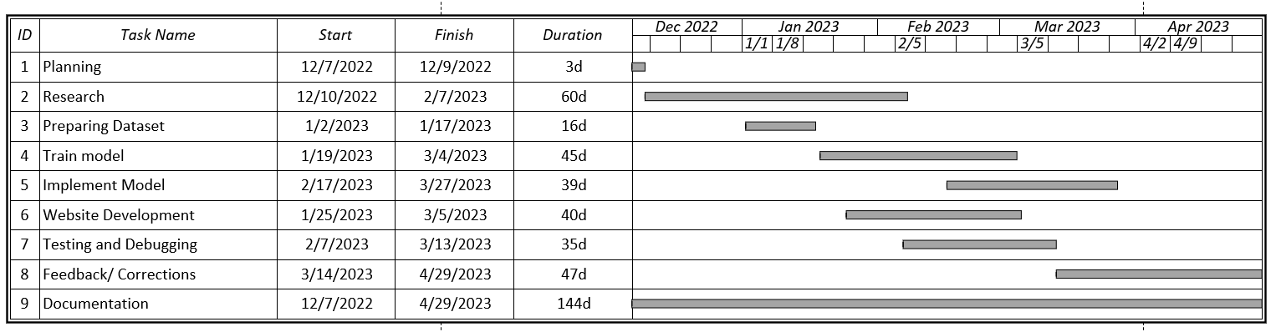
Tentative Timeline
Fig: Gantt Chart

Slide 14
Expected Result
Web-based implementation with simple GUI
The news can be detected fake/real by giving news title/text
Graphical analysis of hybrid-BERT and BERT-base model

Slide 15
References
[1] "'Ghost of Kyiv' killed in fighting, has shot down 40 Russian jets," 27 February 2022. [Online]. Available: https://www.wionews.com/world/ghost-of-kyiv-killed-in-fighting-after-shooting-down-40-russian-jets-475309.
[2] C. Elliott, "forbes," 21 February 2019. [Online]. Available: https://www.forbes.com/sites/christopherelliott/2019/02/21/these-are-the-real-fake-news-sites/?sh=2554c7c23c3e.
[3] D. Adhikari, "Onlinekhabar," 13 December 2022. [Online]. Available: https://english.onlinekhabar.com/misinformation-elections-nepal.html.
[4] K. Stahl, "Fake news detection in social media," 2018.
[5] B. D. P. S. Y. Jiawei Zhang, "FAKEDETECTOR: Effective Fake News Detection," 2019.

Slide 16
[6] S. R. M. K. S. Gowthami. K, "Identification of Fake News through SVM and Random Forest," 2020.
[7] S. K. S. P. R. V. S. P. Tejaswini Yesugade, "Fake News Detection using LSTM," International Research Journal of Engineering and Technology (IRJET), 2021.
[8] S. S. S. M. P. Uma Sharma, "Fake News Detection using Machine Learning Algorithms," International Journal of Engineering Research & Technology (IJERT), 2021.
[9] I. B. D. M. S. A. I. Kadek Sastrawan, "Detection of fake news using deep learning CNN–RNN based methods," 2021.
[10] V. R. H. V. Mahmood Farokhian, "Fake news detection using parallel BERT deep neural networks".

